Slide 1
Basic concepts of Probability (2)
Md. Ismail Hossain Riday

Slide 2
Probability Laws
Two basic rules/laws of probability theory-
Additive rule
Multiplicative rule
Disjoint, Joint events
Independent, Dependent events

Slide 3
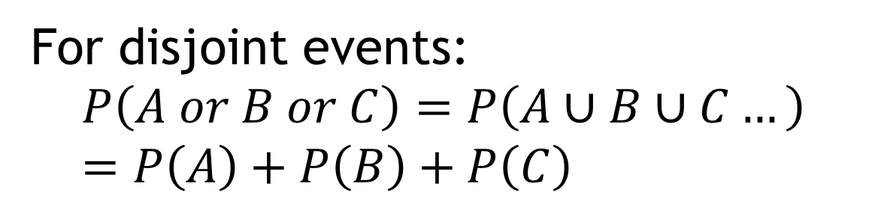
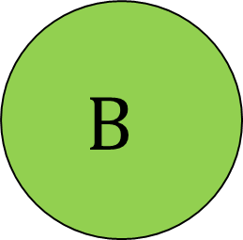
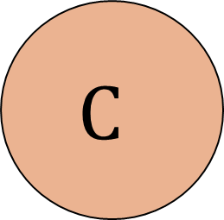

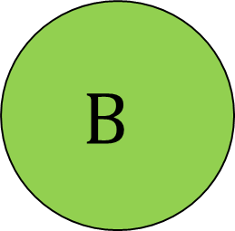

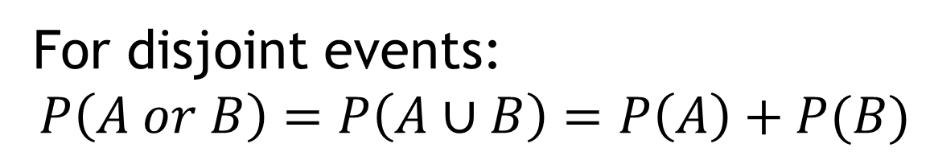
Additive rule
Exclusive/Disjoint events
For disjoint events:
$$P\left(A or B\right)=P\left(A∪B\right)=P\left(A\right)+P(B)$$
$$A$$
$$B$$
Exclusive/Disjoint events
For disjoint events:
$$P\left(A or B or C\right)=P\left(A∪B∪C…\right)=P\left(A\right)+P\left(B\right)+P\left(C\right)$$
$$A$$
$$B$$
$$C$$

Slide 4
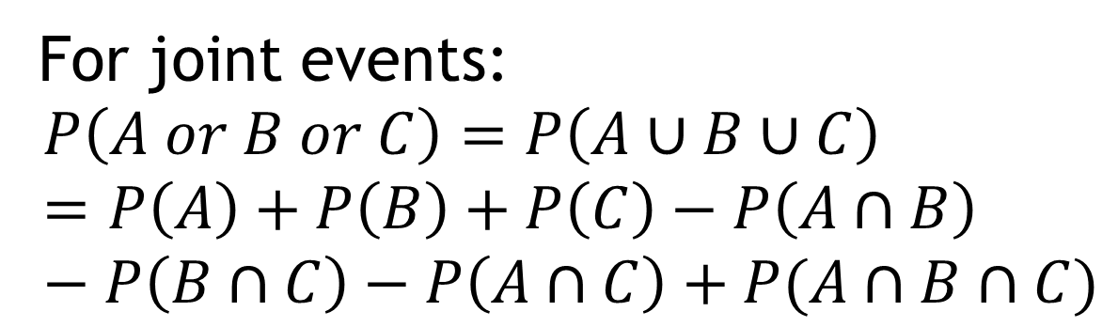





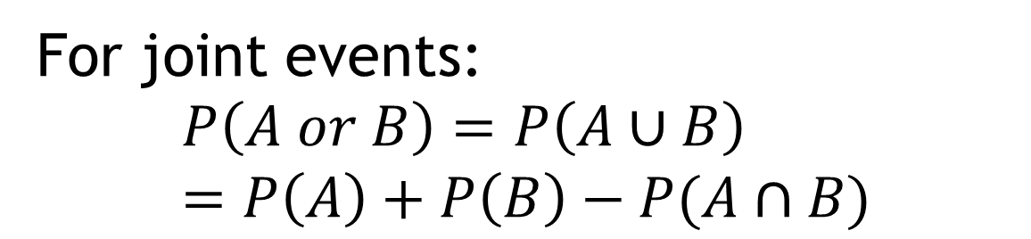
Additive rule
Joint events
For joint events:
$$P\left(A or B\right)=P\left(A∪B\right)=P\left(A\right)+P\left(B\right)−P(A∩B)$$
$$A$$
$$B$$
Joint events
For joint events:
$$P\left(A or B or C\right)=P\left(A∪B∪C\right)=P\left(A\right)+P\left(B\right)+P\left(C\right)−P\left(A∩B\right)−P\left(B∩C\right)−P\left(A∩C\right)+P(A∩B∩C)$$
$$A$$
$$B$$
$$C$$

Slide 5
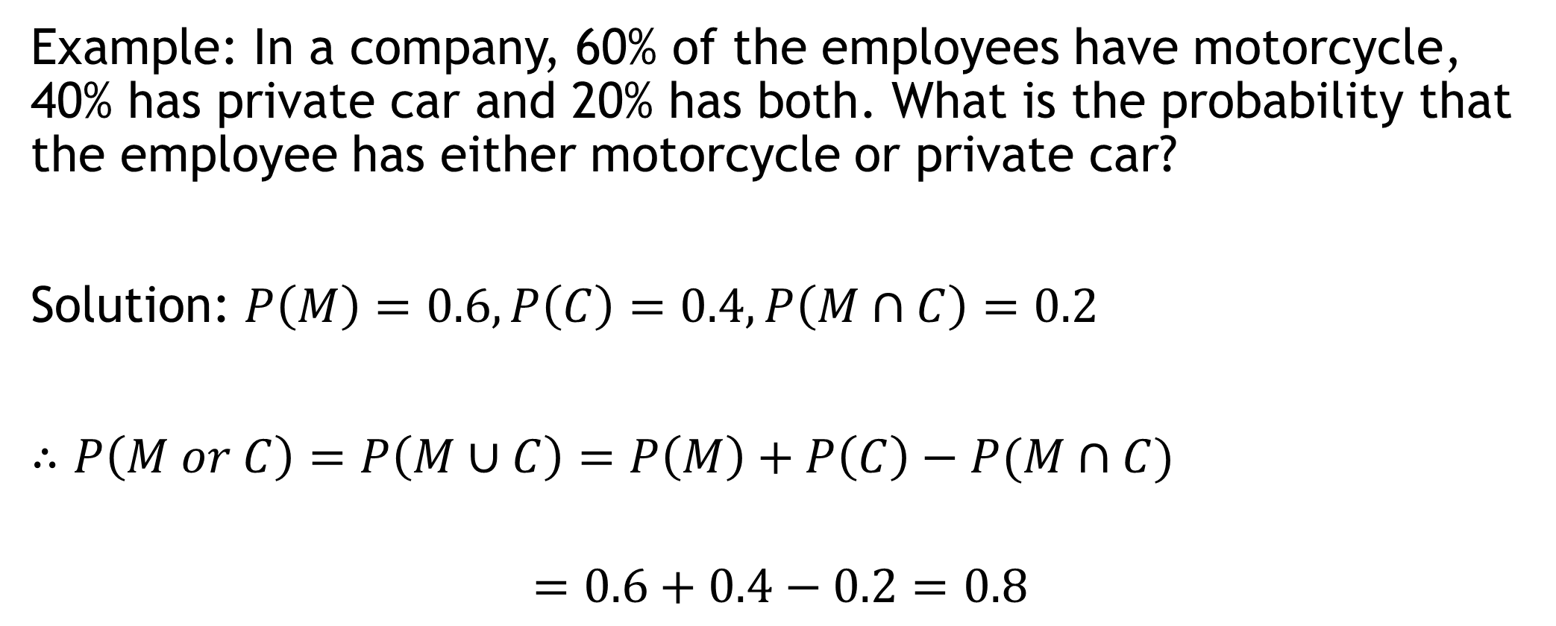
Additive rule
Example: In a company, 60% of the employees have motorcycle, 40% has private car and 20% has both. What is the probability that the employee has either motorcycle or private car?
Solution: $P\left(M\right)=0.6, P\left(C\right)=0.4, P\left(M∩C\right)=0.2$
$∴P\left(M or C\right)=P\left(M∪C\right)=P\left(M\right)+P\left(C\right)−P(M∩C)$
$$=0.6+0.4−0.2=0.8$$
80% employee has either motorcycle or private car

Slide 6
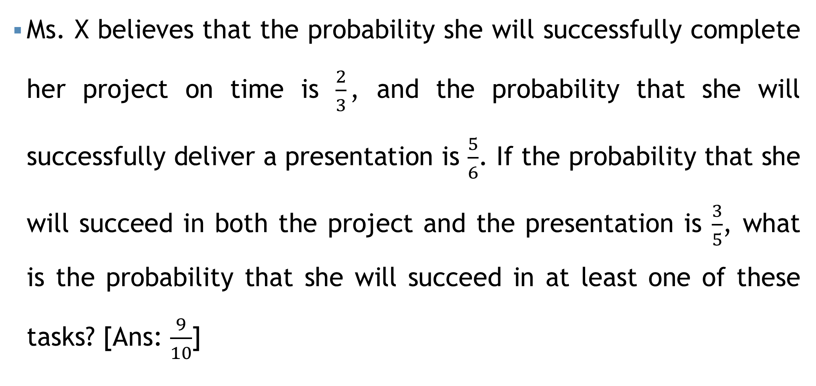
Additive rule
Ms. X believes that the probability she will successfully complete her project on time is $\frac{2}{3}$, and the probability that she will successfully deliver a presentation is $\frac{5}{6}$. If the probability that she will succeed in both the project and the presentation is $\frac{3}{5}$, what is the probability that she will succeed in at least one of these tasks? [Ans: $\frac{9}{10}$]

Slide 7
Additive rule
In a certain residential suburb, 60% of all households get Internet service from the local cable company, 80% get television service from that company, and 50% get both services from that company. If a household is randomly selected, what is the probability that it gets at least one of these two services from the company, and what is the probability that it gets exactly one of these services from the company? [Ans: 0.9, 0.4]

Slide 8



Additive rule
$$A$$
$$B$$
$$C$$
Consider a dartboard with a bullseye and two concentric rings around it. The probability of hitting the bullseye is 0.15, the probability of hitting the inner ring is 0.30, and the probability of hitting the outer ring is 0.40.
What is the probability that the projectile hits the target?
What is the probability that it misses the target?
Ans: 0.85
Ans: 1-0.85=???

Slide 9

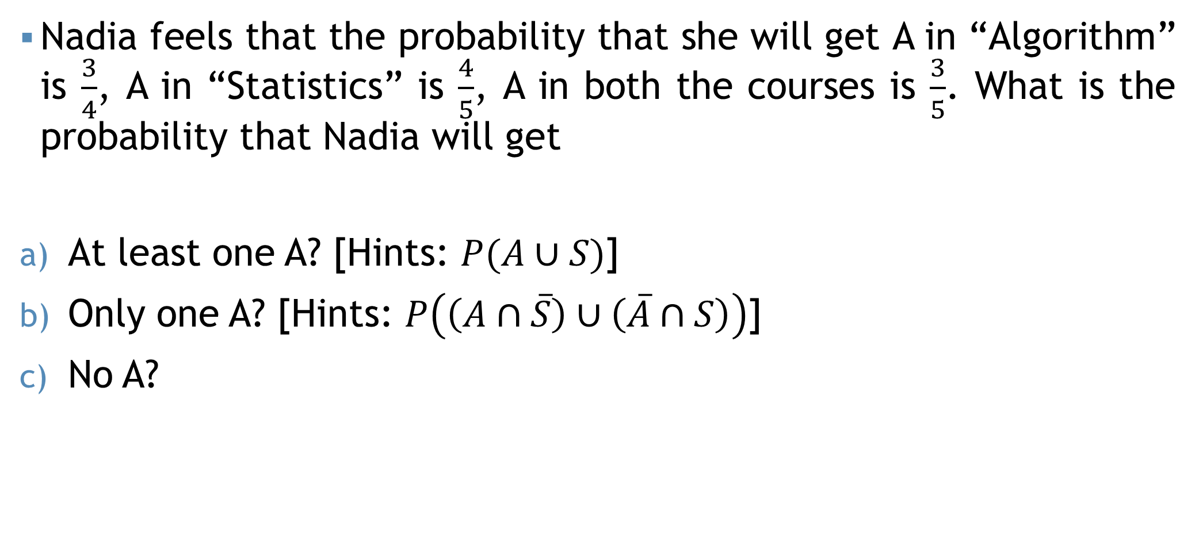

Self Practice
Nadia feels that the probability that she will get A in “Algorithm” is $\frac{3}{4}$, A in “Statistics” is $\frac{4}{5}$, A in both the courses is $\frac{3}{5}$. What is the probability that Nadia will get
At least one A? [Hints: $P(A∪S)$]
Only one A? [Hints: $P\left(\left(A∩\overline{S}\right)∪\left(\overline{A}∩S\right)\right)$]
No A?
$$A$$
$$S$$

Slide 10



Self Practice
A sample survey was undertaken to investigate which papers A, B, and C people read. In survey of 100 people following results were obtained: 60 people read A, 40 people read B, 70 people read C, 32 people read A and B, 45 people read A and C, 38 people read B and C, 30 people read A, B, C. If a person is selected at random, find the probability,
Read only newspaper A.
Read only one news paper.
Read at least one news paper.
Read at most one news paper.
Ans: 0.13
$$A$$
$$B$$
Ans: 0.3
$$C$$
Ans: 0.85
Ans: 0.45

Slide 11
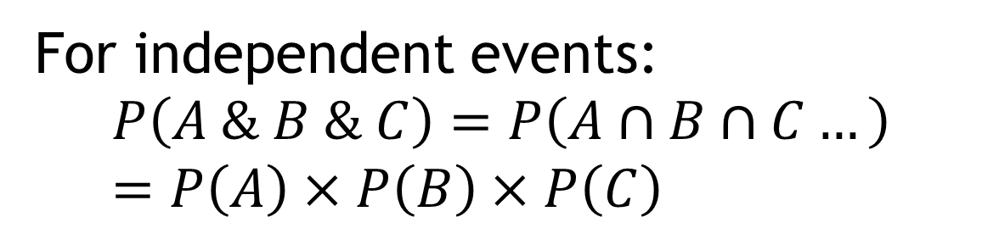
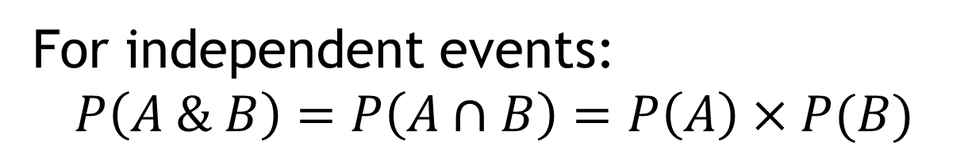
Multiplicative rule
Independent events
For independent events:
$$P\left(A \& B\right)=P\left(A∩B\right)=P\left(A\right)×P(B)$$
$$A$$
$$B$$
Independent events
For independent events:
$$P\left(A \& B \& C\right)=P\left(A∩B∩C…\right)=P\left(A\right)×P\left(B\right)×P\left(C\right)$$
$$A$$
$$B$$
$$C$$

Slide 12
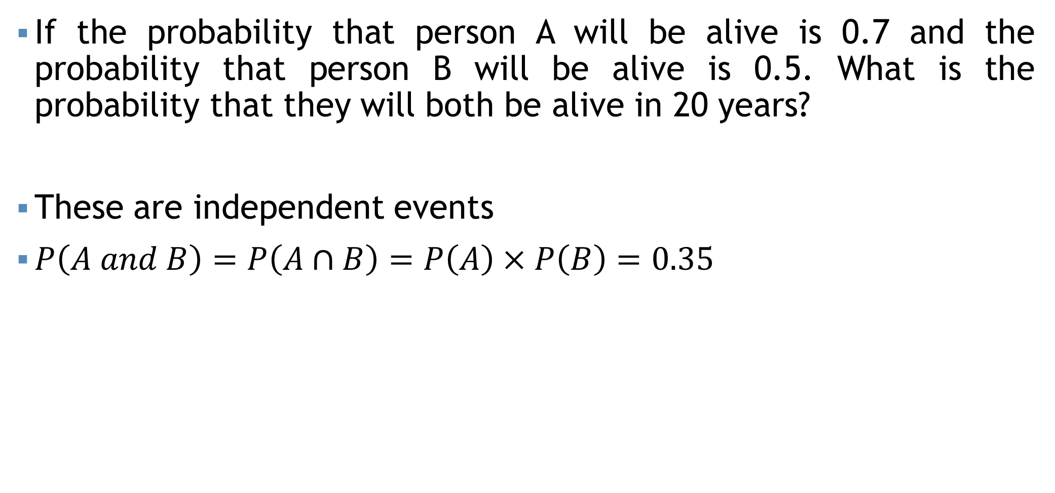
Multiplicative rule
If the probability that person A will be alive is 0.7 and the probability that person B will be alive is 0.5. What is the probability that they will both be alive in 20 years?
These are independent events
$P\left(A and B\right)=P\left(A∩B\right)=P\left(A\right)×P\left(B\right)=0.35$

Slide 13
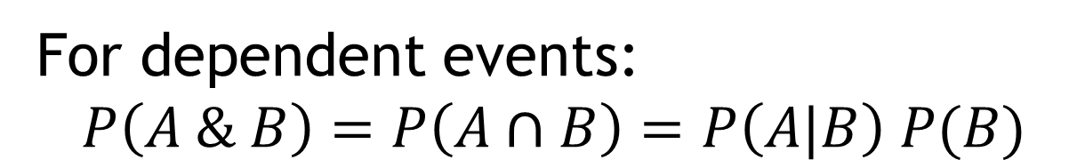
Multiplicative rule
For dependent events:
$$P\left(A \& B\right)=P\left(A∩B\right)=P\left(A|B\right) P(B)$$
Conditional probability
Probability of A “given that” B

Slide 14
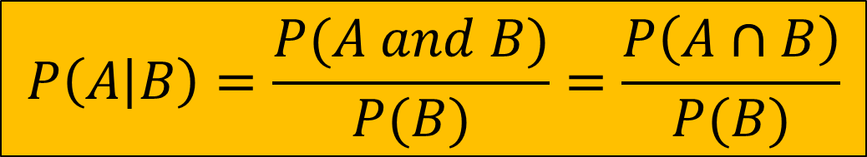
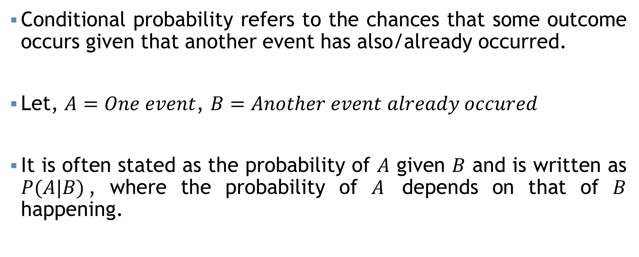
Conditional Probability
Conditional probability refers to the chances that some outcome occurs given that another event has also/already occurred.
Let, $A=One event$, $B=Another event already occured$
It is often stated as the probability of $A$ given $B$ and is written as $P(A|B)$, where the probability of $A$ depends on that of $B$ happening.
$$P\left(A | B\right)=\frac{P(A and B)}{P(B)}=\frac{P\left(A∩B\right)}{P(B)}$$

Slide 15
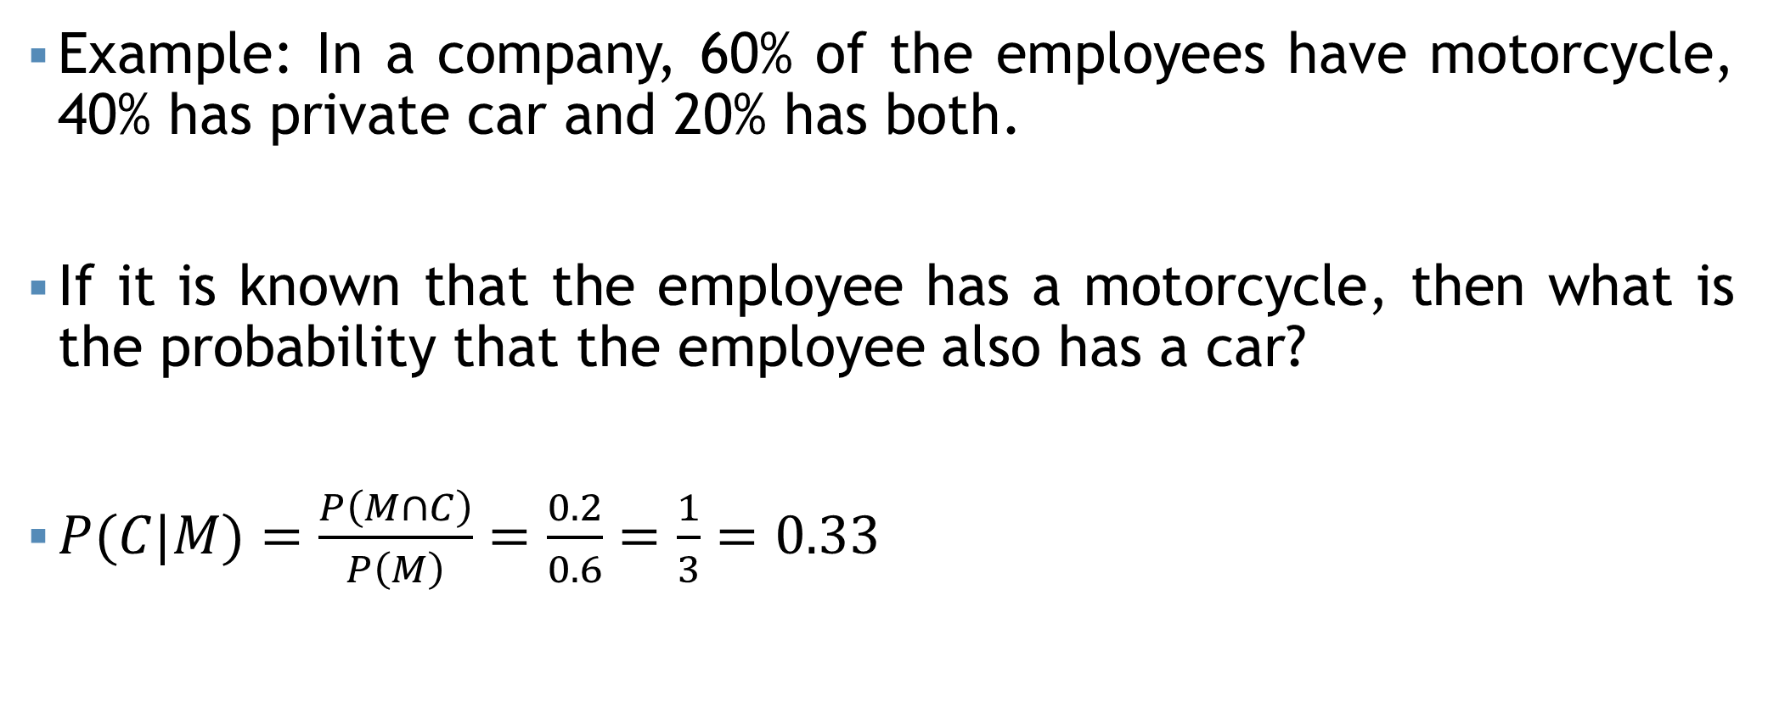
Conditional Probability
Example: In a company, 60% of the employees have motorcycle, 40% has private car and 20% has both.
If it is known that the employee has a motorcycle, then what is the probability that the employee also has a car?
$P(C|M)=\frac{P\left(M∩C\right)}{P\left(M\right)}=\frac{0.2}{0.6}=\frac{1}{3}=0.33$

Slide 16
Conditional Probability
Suppose a balanced die is rolled once.
Find the probability that a number divisible by 3 is rolled given that the die comes up even.
Find the probability that the die comes up even given that a number divisible by 3 is rolled.
Find the probability that a number divisible by 3 is rolled given that die comes up at most 4.
Find the probability that the die comes up at most 4 given that a number divisible by 3 is rolled.

Slide 17



Conditional Probability
Sample space for rolling a die once, $S=\left\{1, 2, 3, 4, 5, 6\right\}$
a) Let,
$A=Number divisible by 3=\left\{3, 6\right\}$
$B=Even number=\left\{2, 4, 6\right\}$
$P\left(A | B\right)=\frac{P(A∩B)}{P(B)}$
$∴P\left(A | B\right)=\frac{\frac{1}{6}}{\frac{1}{2}}=0.33$
Probability that a number divisible by 3 is rolled given that the die comes up even.
$$A∩B=\left\{3, 6\right\}∩\left\{2, 4, 6\right\}=\left\{6\right\}$$
$$P\left(A∩B\right)=\frac{1}{6}$$
$$B=\left\{2, 4, 6\right\}$$
$$P\left(B\right)=\frac{3}{6}=\frac{1}{2}$$

Slide 18

Conditional Probability
b) $\left(Ans:0.5\right)$
c) $\left(Ans:0.25\right)$
d) $\left(Ans:0.5\right)$

Slide 19
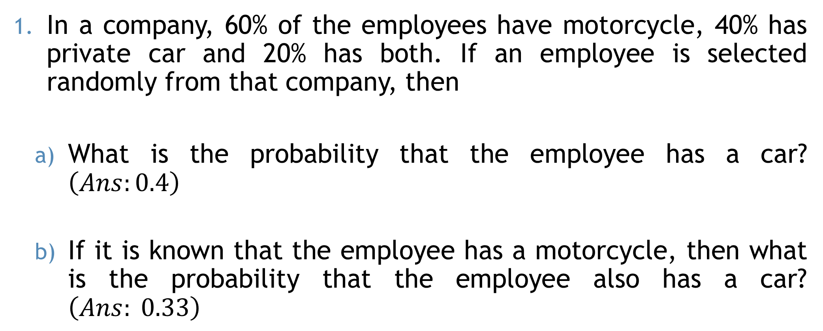
Conditional Probability
In a company, 60% of the employees have motorcycle, 40% has private car and 20% has both. If an employee is selected randomly from that company, then
What is the probability that the employee has a car? $\left(Ans:0.4\right)$
If it is known that the employee has a motorcycle, then what is the probability that the employee also has a car? $\left(Ans: 0.33\right)$

Slide 20


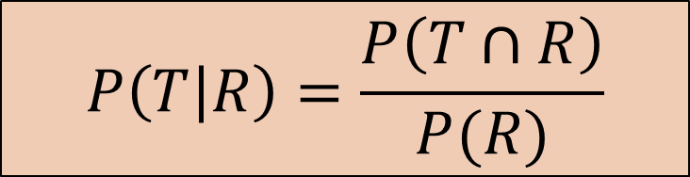
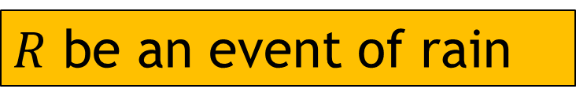



Conditional Probability
In rainy season, it rains 70% of the days in Bangladesh. When it rains, 80% times it makes thunderstorms. What is the probability that, in a particular day of rainy season, it will rain and it will thunderstorm?
$R$ be an event of rain
$T$ be an event of Thunderstorms
$$P\left(R and T\right)=P(R∩T)$$
$P\left(R\right)=70\%=0.7$
$$P\left(T | R\right)=80\%=0.8$$
$$P\left(T | R\right)=\frac{P\left(T∩R\right)}{P(R)}$$
$$P\left(T∩R\right)=P\left(T | R\right)×P\left(R\right)$$
$$P\left(T∩R\right)=0.8×0.7=0.56$$

Slide 21
Self Practice
Mr. Fahad and Mr. Khan has to tour abroad for their business frequently. Mr. Fahad tours 65% of the times in a year at abroad and Mr. Khan tours 50% of the times in a year at abroad. What is the probability that, on January 01, 2016, both Mr. Fahad and Mr. Khan will be at abroad?

Slide 22

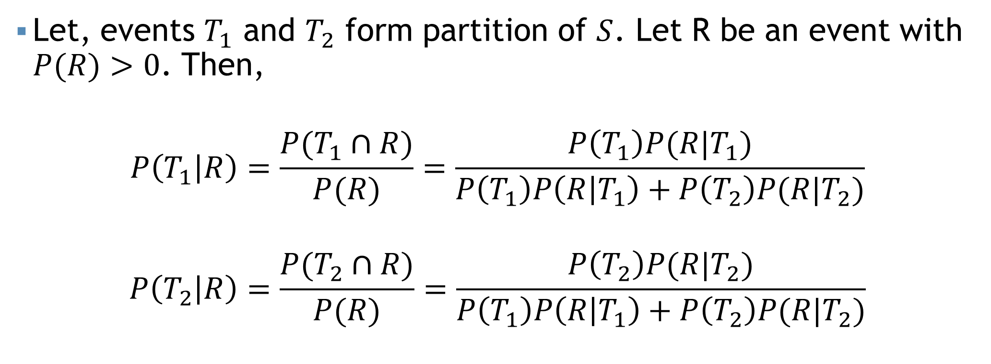


Bayes' Theorem
$$T_{1}$$
$$T_{2}$$
$$R$$
Let, events $T_{1}$ and $T_{2}$ form partition of $S$. Let R be an event with $P(R)>0$. Then,
$$P\left(T_{1} | R\right)=\frac{P(T_{1}∩R)}{P(R)}=\frac{P\left(T_{1}\right)P(R|T_{1})}{P\left(T_{1}\right)P\left(R | T_{1}\right)+P\left(T_{2}\right)P(R|T_{2})}$$
$$P\left(T_{2} | R\right)=\frac{P(T_{2}∩R)}{P(R)}=\frac{P\left(T_{2}\right)P(R|T_{2})}{P\left(T_{1}\right)P\left(R | T_{1}\right)+P\left(T_{2}\right)P(R|T_{2})}$$

Slide 23
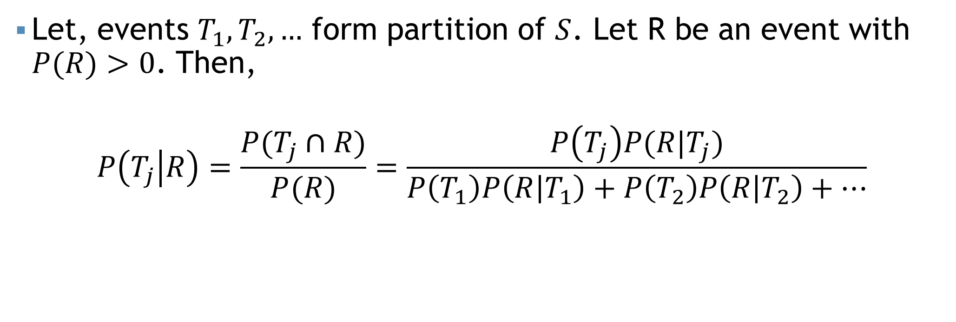
Bayes' Theorem
$$R$$
Let, events $T_{1},T_{2},…$ form partition of $S$. Let R be an event with $P(R)>0$. Then,
$$P\left(T_{j} | R\right)=\frac{P(T_{j}∩R)}{P(R)}=\frac{P\left(T_{j}\right)P(R|T_{j})}{P\left(T_{1}\right)P\left(R | T_{1}\right)+P\left(T_{2}\right)P\left(R | T_{2}\right)+…}$$

Slide 24
Example
60% of the students in a class are male. 5% of the males and 10% of the females are in the photography club. If a student is randomly selected from the class.
What is the probability that the student is in photography club?
If the randomly selected student is in the photography club, what is the chance that the student is male?

Slide 25

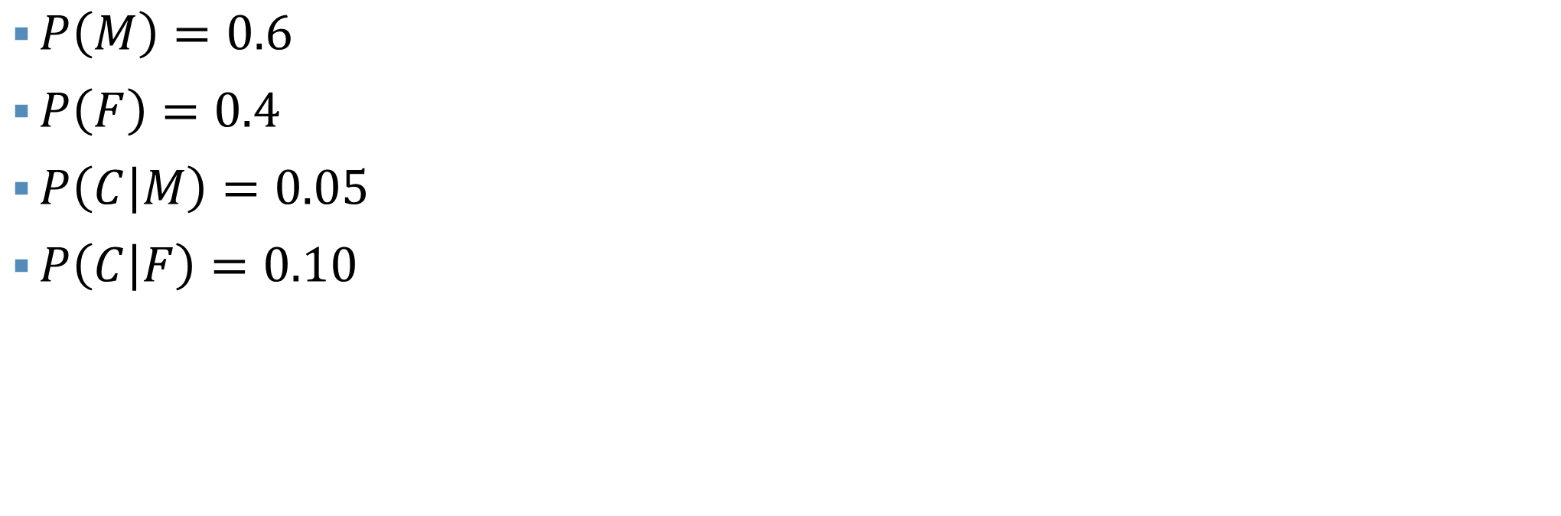
Solution
$$60\% of the students in a class are male$$
$$40\% of the students in a class are female$$
$$5\% of the males are in the photography club$$
$$10\% of the females are in the photography club$$
$P\left(M\right)=0.6$
$P\left(F\right)=0.4$
$P\left(C | M\right)=0.05$
$P\left(C | F\right)=0.10$
a) What is the probability that the student is in photography club?
$$P\left(C\right)=P\left(M\right)P\left(C | M\right)+P\left(F\right)P\left(C | F\right)=0.07$$
b) If the randomly selected student is in the photography club, what is the chance that the student is male?
$$P\left(M | C\right)=\frac{P\left(M\right)P\left(C | M\right)}{P(C)}=0.43$$

Slide 26
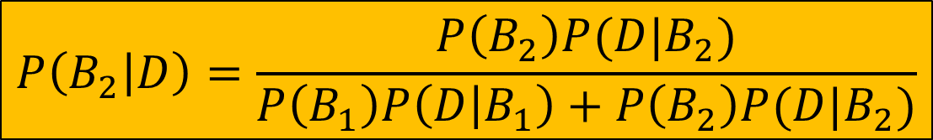






Example
$$P\left({D|B}_{1}\right)=0.3$$
$$P\left({D|B}_{2}\right)=0.9$$
Dr. X diagnoses cancer correctly 80% cases. The chance that a patient will die by his treatment after correct diagnosis is 30%, and the chance of death by wrong diagnosis is 90%. A patient of Dr. X who had cancer died. What is the probability that his diagnosis was wrong?
$$P\left(B_{2}\right)=0.2$$
$$B_{1}=Cancer is correctly diagnosis$$
$$B_{2}=Cancer is not correctly diagnosis$$
$$P\left(B_{1}\right)=0.8$$
$$D=Cancer patient died$$
$$P\left(B_{2} | D\right)=????$$
$$P\left(B_{2} | D\right)=\frac{P\left(B_{2}\right)P(D|B_{2})}{P\left(B_{1}\right)P\left(D | B_{1}\right)+P\left(B_{2}\right)P(D|B_{2})}$$

Slide 27
Example
a) What is the probability that a randomly selected purchaser has a DVD player that will need repair while under warranty? [Ans: 0.205]
b) If a customer returns to the store with a DVD player that needs warranty repair work, what is the probability that it is a brand 1 DVD player? A brand 2 DVD player? A brand 3 DVD player? [Ans: 0.61, 0.29, 0.10]
An electronics store sells three different brands of DVD players. Of its DVD player sales, 50% are brand 1 (the least expensive), 30% are brand 2, and 20% are brand 3. Each manufacturer offers a 1-year warranty on parts and labor. It is known that 25% of brand 1’s DVD players require warranty repair work, whereas the corresponding percentages for brands 2 and 3 are 20% and 10%, respectively.

Slide 28
Example
An individual has 3 different email accounts. Most of her messages, in fact 70%, come into account “alpha”, whereas 20% come into account “beta” and the remaining 10% into account “gamma”. Of the messages into account “alpha”, only 1% are spam, whereas the corresponding percentages for accounts “beta” and “gamma” are 2% and 5%, respectively. What is the probability that a randomly selected message is spam? [Ans: 0.016]

Slide 29
Contingency table
A contingency table, also known as a cross-tabulation or crosstab, is a statistical table used to analyze and display the relationship between two categorical variables.
For example, The question, "Do you like watching TV?" was asked of 100 people. Results are shown in the table.
 | Yes | No | Total
Male | 19 | 41 | 60
Female | 12 | 28 | 40
Total | 31 | 69 | 100

Slide 30
Joint Probability
Both event occur together
For example, The question, "Do you like watching TV?" was asked of 100 people. What is the probability of a randomly selected individual being a male who likes watching TV?
 | Yes | No | Total
Male | 19 | 41 | 60
Female | 12 | 28 | 40
Total | 31 | 69 | 100

Slide 31
Joint Probability
Both event occur together
For example, The question, "Do you like watching TV?" was asked of 100 people. What is the probability of a randomly selected individual being a male who likes watching TV?
 | Yes | No | Total
Male | 19 | 41 | 60
Female | 12 | 28 | 40
Total | 31 | 69 | 100

Slide 32
Marginal Probability
Single event occurring independently of any other events.
For example, The question, "Do you like watching TV?" was asked of 100 people. What is the probability of a randomly selected individual like watching TV?
 | Yes | No | Total
Male | 19 | 41 | 60
Female | 12 | 28 | 40
Total | 31 | 69 | 100

Slide 33
Marginal Probability
Single event occurring independently of any other events.
For example, The question, "Do you like watching TV?" was asked of 100 people. What is the probability of a randomly selected individual like watching TV?
 | Yes | No | Total
Male | 19 | 41 | 60
Female | 12 | 28 | 40
Total | 31 | 69 | 100

Slide 34
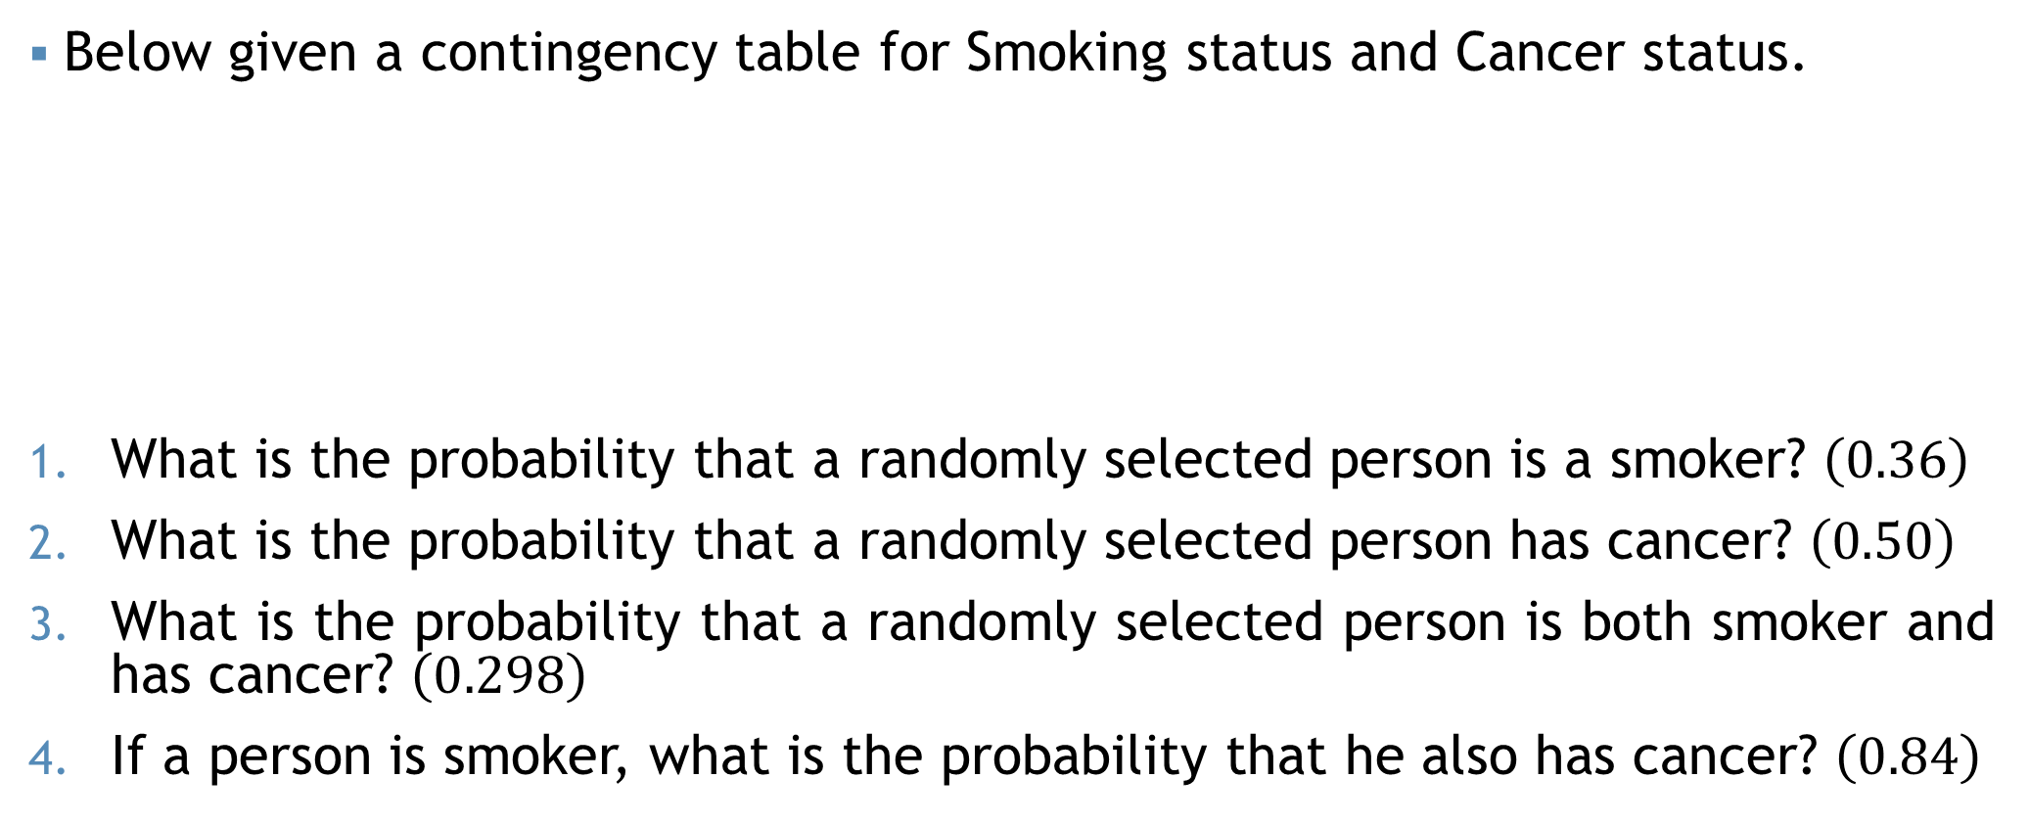
Example
Below given a contingency table for Smoking status and Cancer status.
What is the probability that a randomly selected person is a smoker? $\left(0.36\right)$
What is the probability that a randomly selected person has cancer? $\left(0.50\right)$
What is the probability that a randomly selected person is both smoker and has cancer? $\left(0.298\right)$
If a person is smoker, what is the probability that he also has cancer? $\left(0.84\right)$
 | Cancer | Healthy | Total
Smoker | 7860 | 1530 | 9390
Non smoker | 5390 | 11580 | 16970
Total | 13250 | 13110 | 26360

Slide 35
Some Notations
For two events (A, B):
$P\left(Only A\right)=P\left(A∩B^{′}\right)=P\left(A\right)−P\left(A∩B\right)$
$P\left(Only B\right)=P\left(A^{′}∩B\right)=P\left(B\right)−P(A∩B)$
$P\left(Neither A nor B\right)=P\left(A^{′}∩B^{′}\right)=1−P\left(A∪B\right)$
$P\left(Exactly one\right)=P\left(Only A\right)+P\left(Only B\right)$
$P\left(At most one\right)=1−P(A∩B)$
For Three events (A, B, C):
$P\left(Only A\right)=P\left(A∩B^{′}∩C′\right)=P\left(A\right)−P\left(A∩B\right)−P\left(A∩C\right)+P(A∩B∩C)$
$P\left(Only B\right)=P\left(A^{′}∩B∩C′\right)$; $P\left(Only C\right)=P(A^{′}∩B^{′}∩C)$
$P\left(None of events\right)=P\left(A^{′}∩B^{′}∩C′\right)$
$P\left(Exactly one\right)=P\left(Only A\right)+P\left(Only B\right)+P(Only C)$
$P\left(At most one\right)=1−P(A∩B∩C)$
$P\left(Only A and B \left(not C\right)\right)=P\left(A∩B∩C^{′}\right)=P(A∩B)−P(A∩B∩C)$
$P\left(Only A and C \left(not B\right)\right)=P(A∩C∩B^{′})$; $P\left(Only B and C \left(not A\right)\right)=???$

Slide 36
Mathematical exercise
To access additional mathematical problems, please refer to the PDF lecture notes.

Slide 37
Thank You

